Slide 1
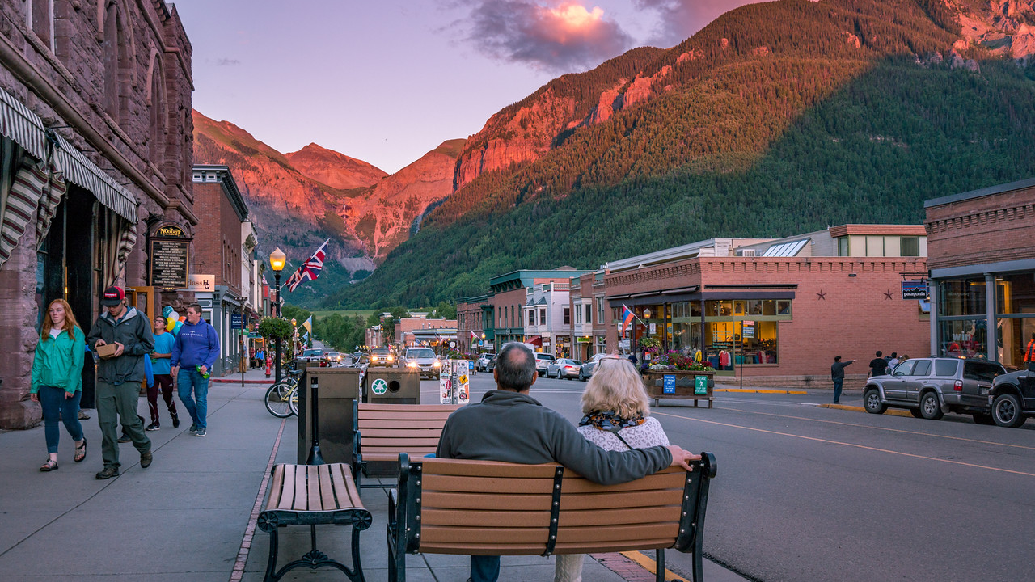
Telluride 3D Trails Map
-ArcGIS JS API Web App

Slide 2
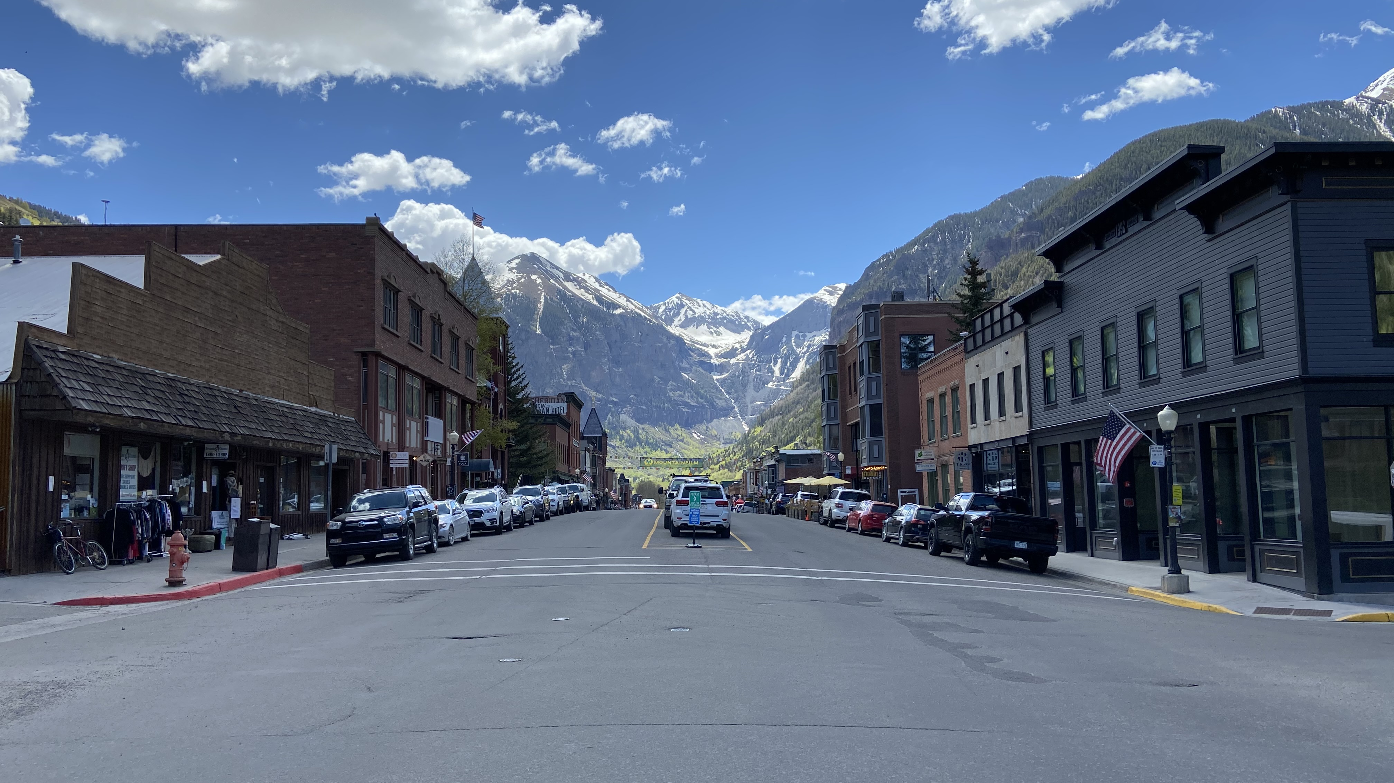

Slide 3
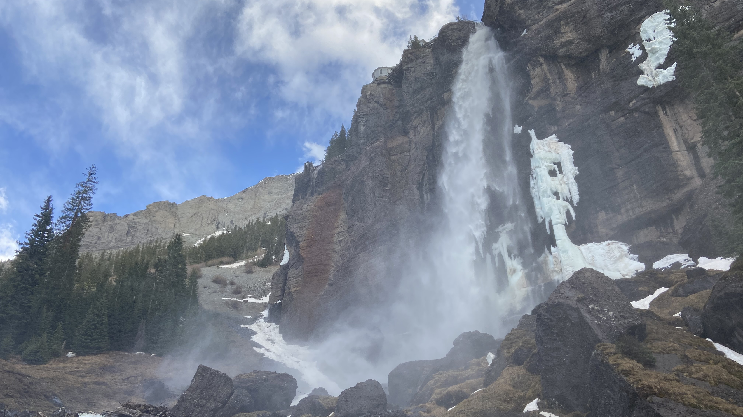

Slide 4
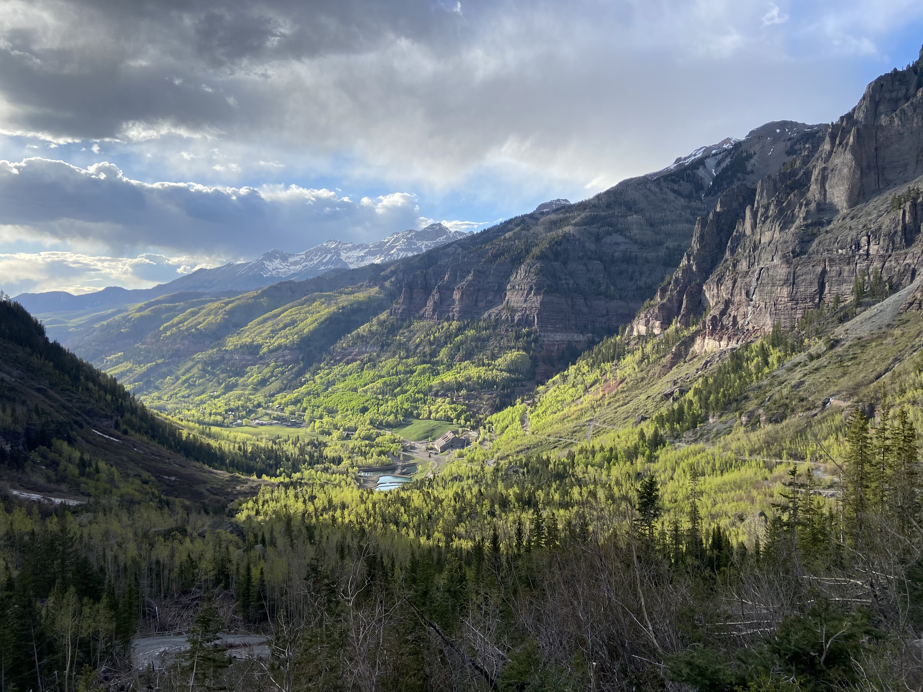

Slide 5
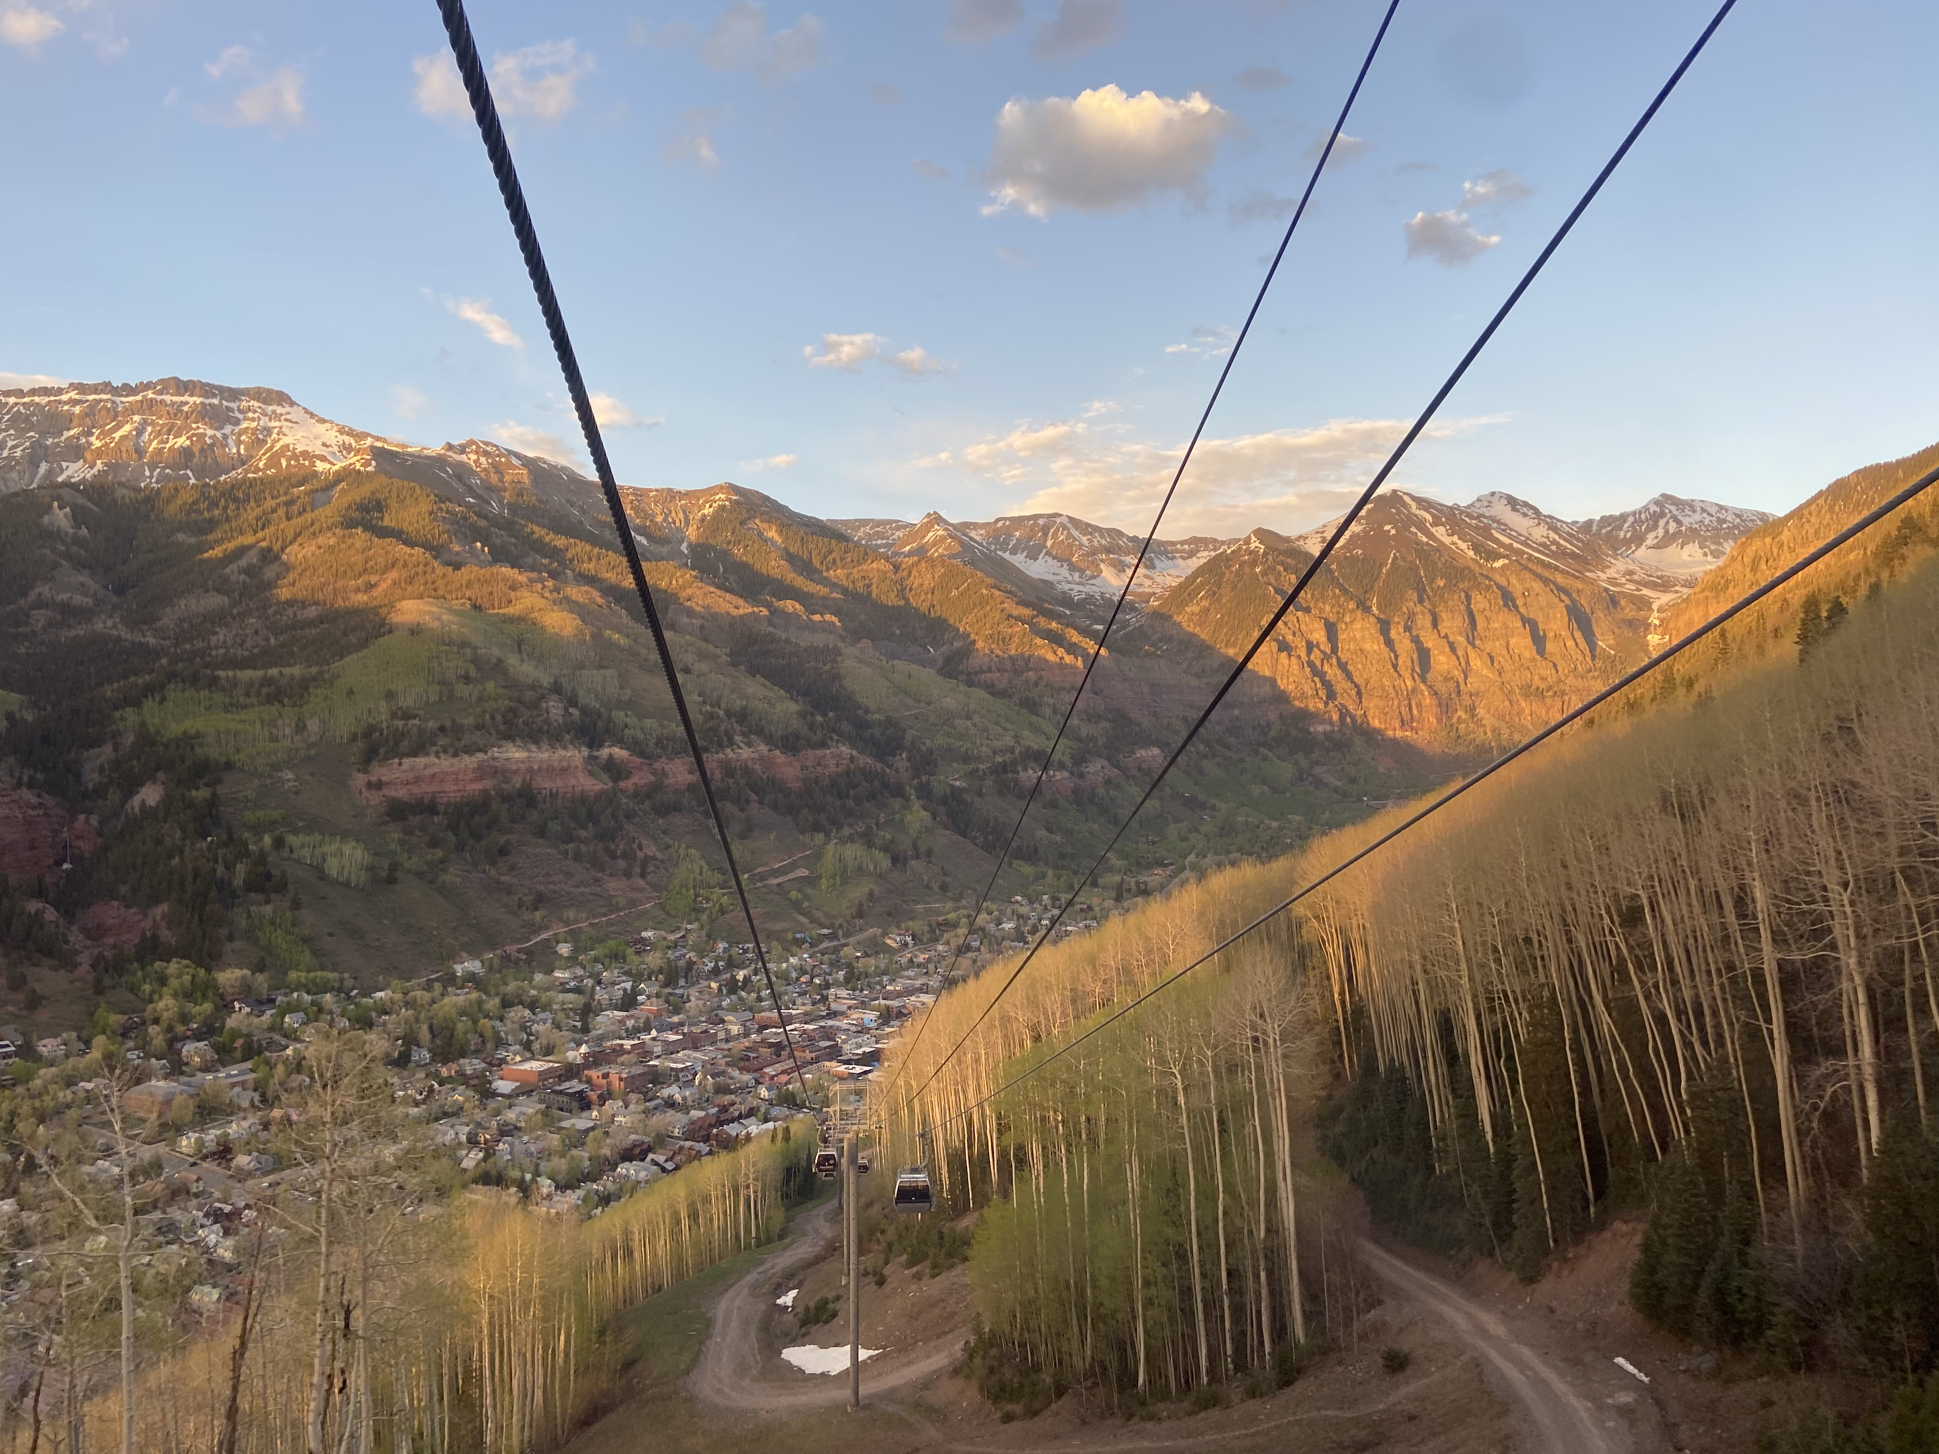

Slide 6
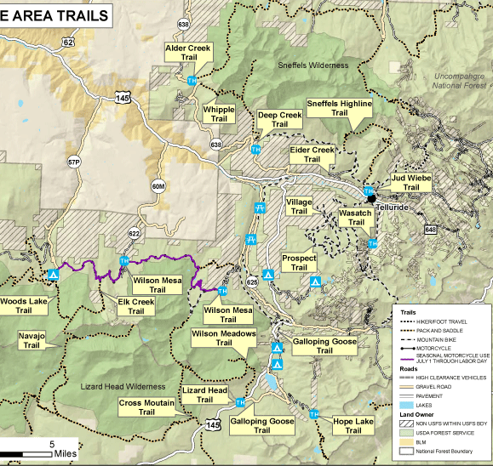
It can be overwhelming
Over 70 trails in the area
2 wilderness areas

Slide 7
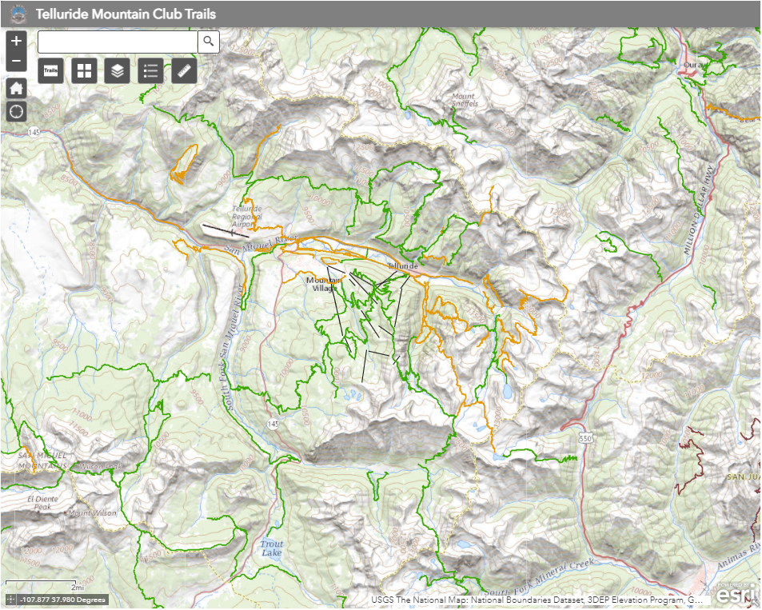
Kudos to TMC

Slide 8
Kudos to TMC -But…
Lack of trails info
Limited functionalities
Only available in 2D
Symbology not very informative

Slide 9
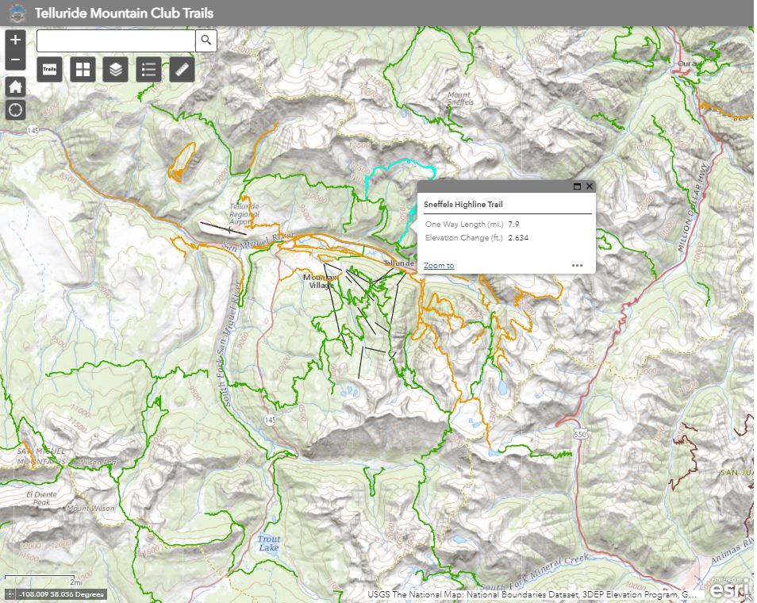
Kudos to TMC -But…
Lack of trails info
Limited functionalities
Only available in 2D
Symbology not very informative

Slide 10
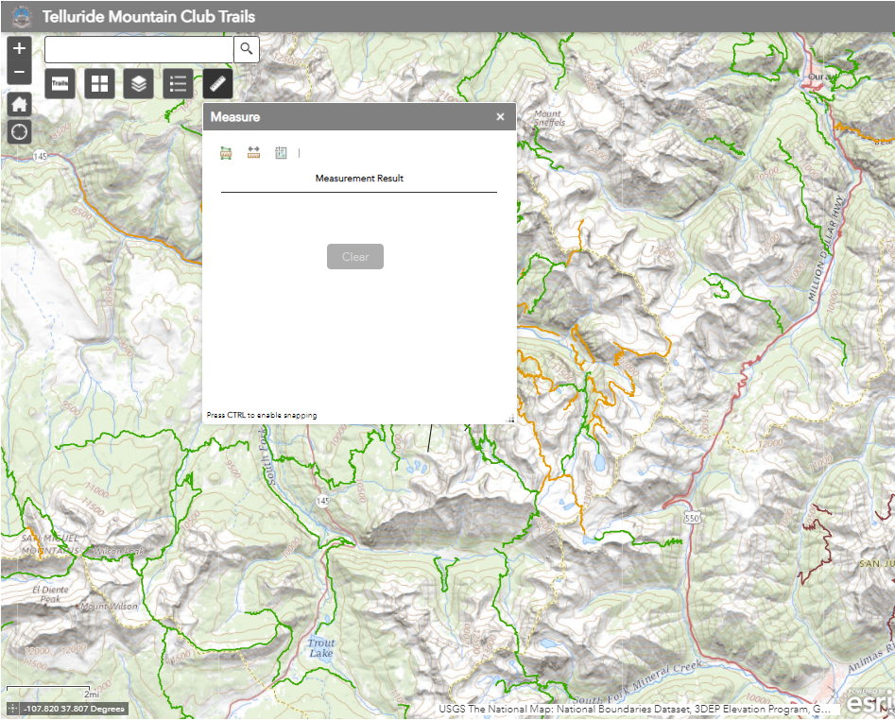
Kudos to TMC -But…
Lack of trails info
Limited functionalities
Only available in 2D
Symbology not very informative

Slide 11
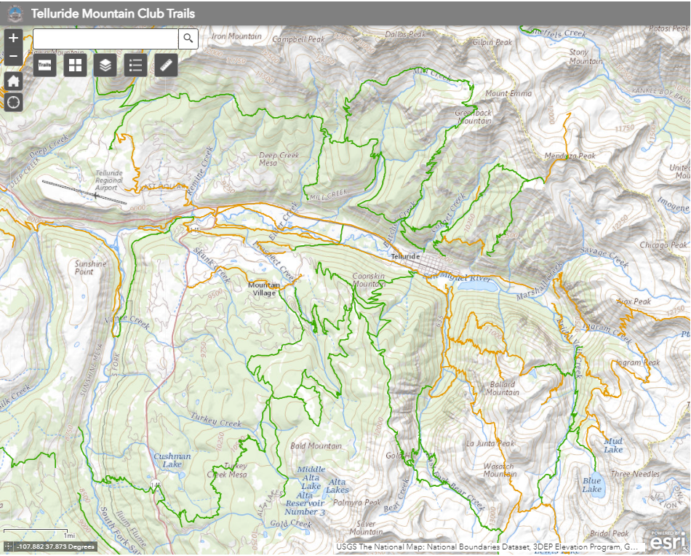
Kudos to TMC -But…
Lack of trails info
Limited functionalities
Only available in 2D
Symbology not very informative

Slide 12
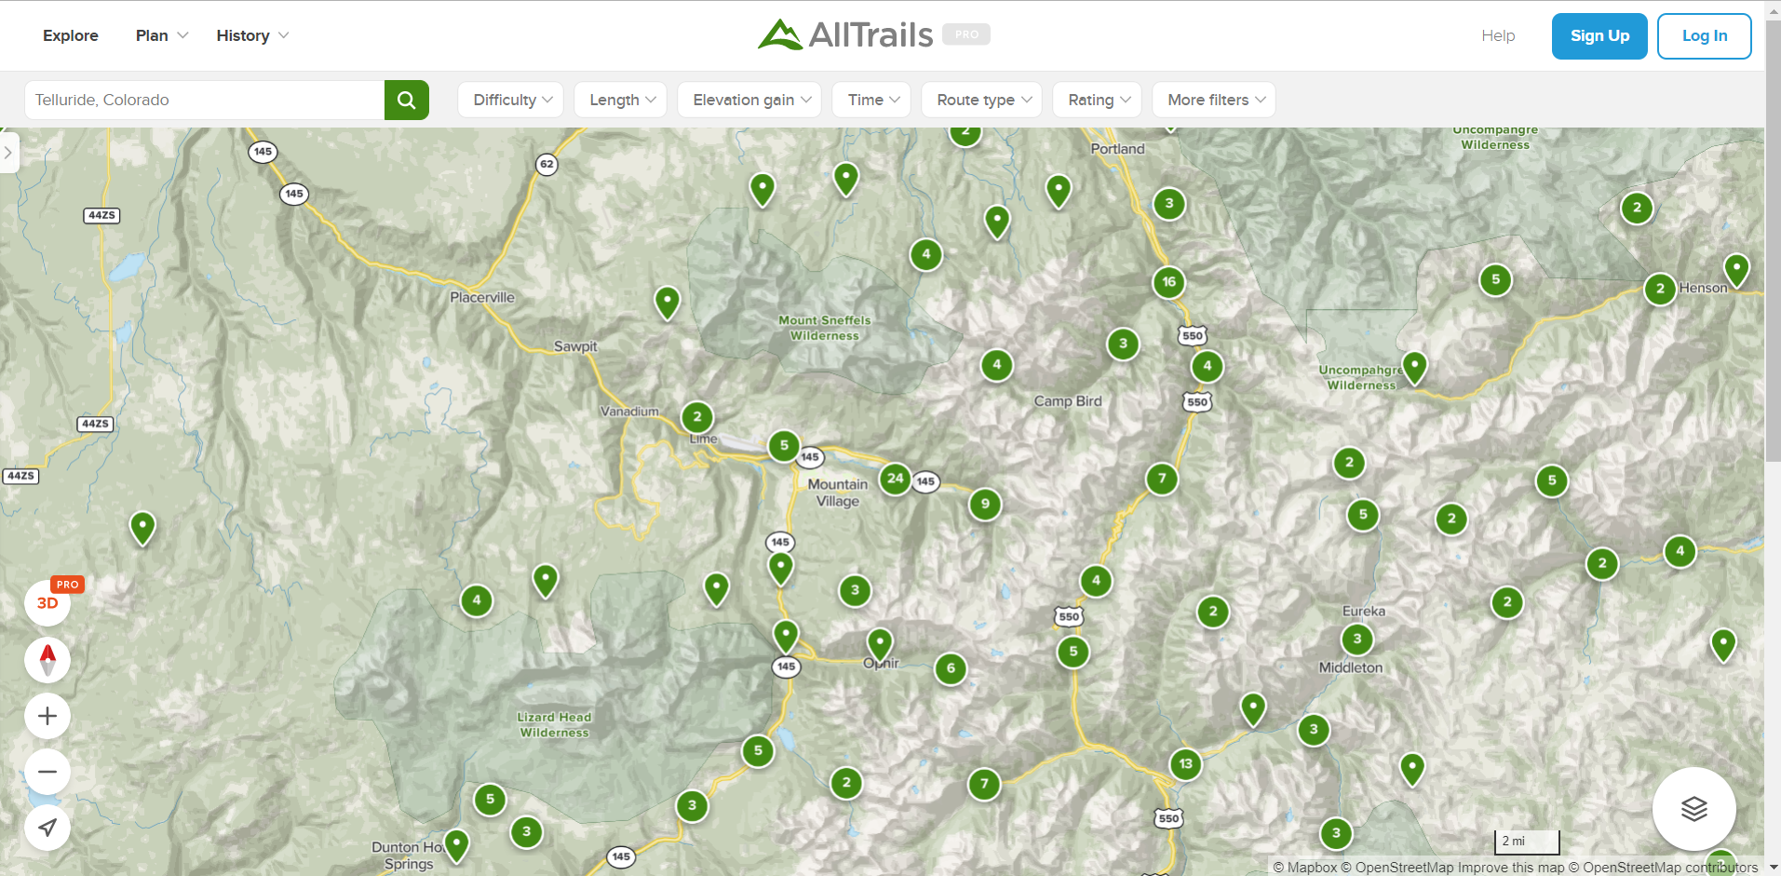

Slide 13
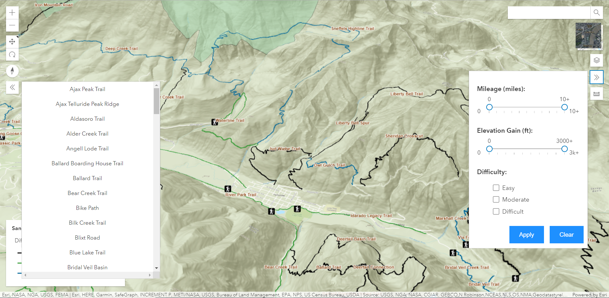
Simple, intuitive user experience
Essential functionalities
Informative data and popups
3D

Slide 14
What I learned
JavaScript (asynchronous operations, promises, rendering, web dev)
ArcGIS API for JS (It offers so much!)
GIS (ArcGIS Online, ArcGIS Pro)

Slide 15
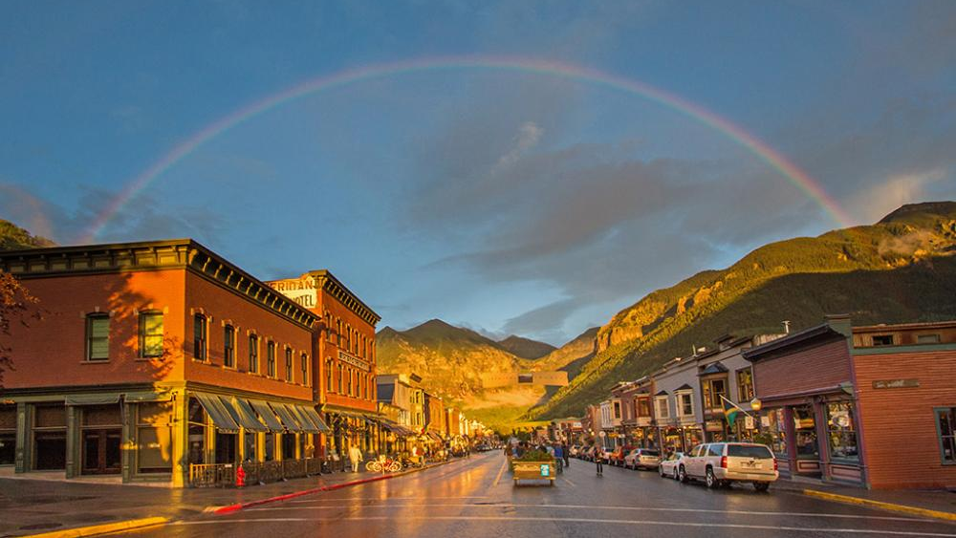
The road ahead
UX/UI design using JS framework
Continue to work with ArcGIS JS API and maybe more in the future
Keep appreciating nature

Slide 16
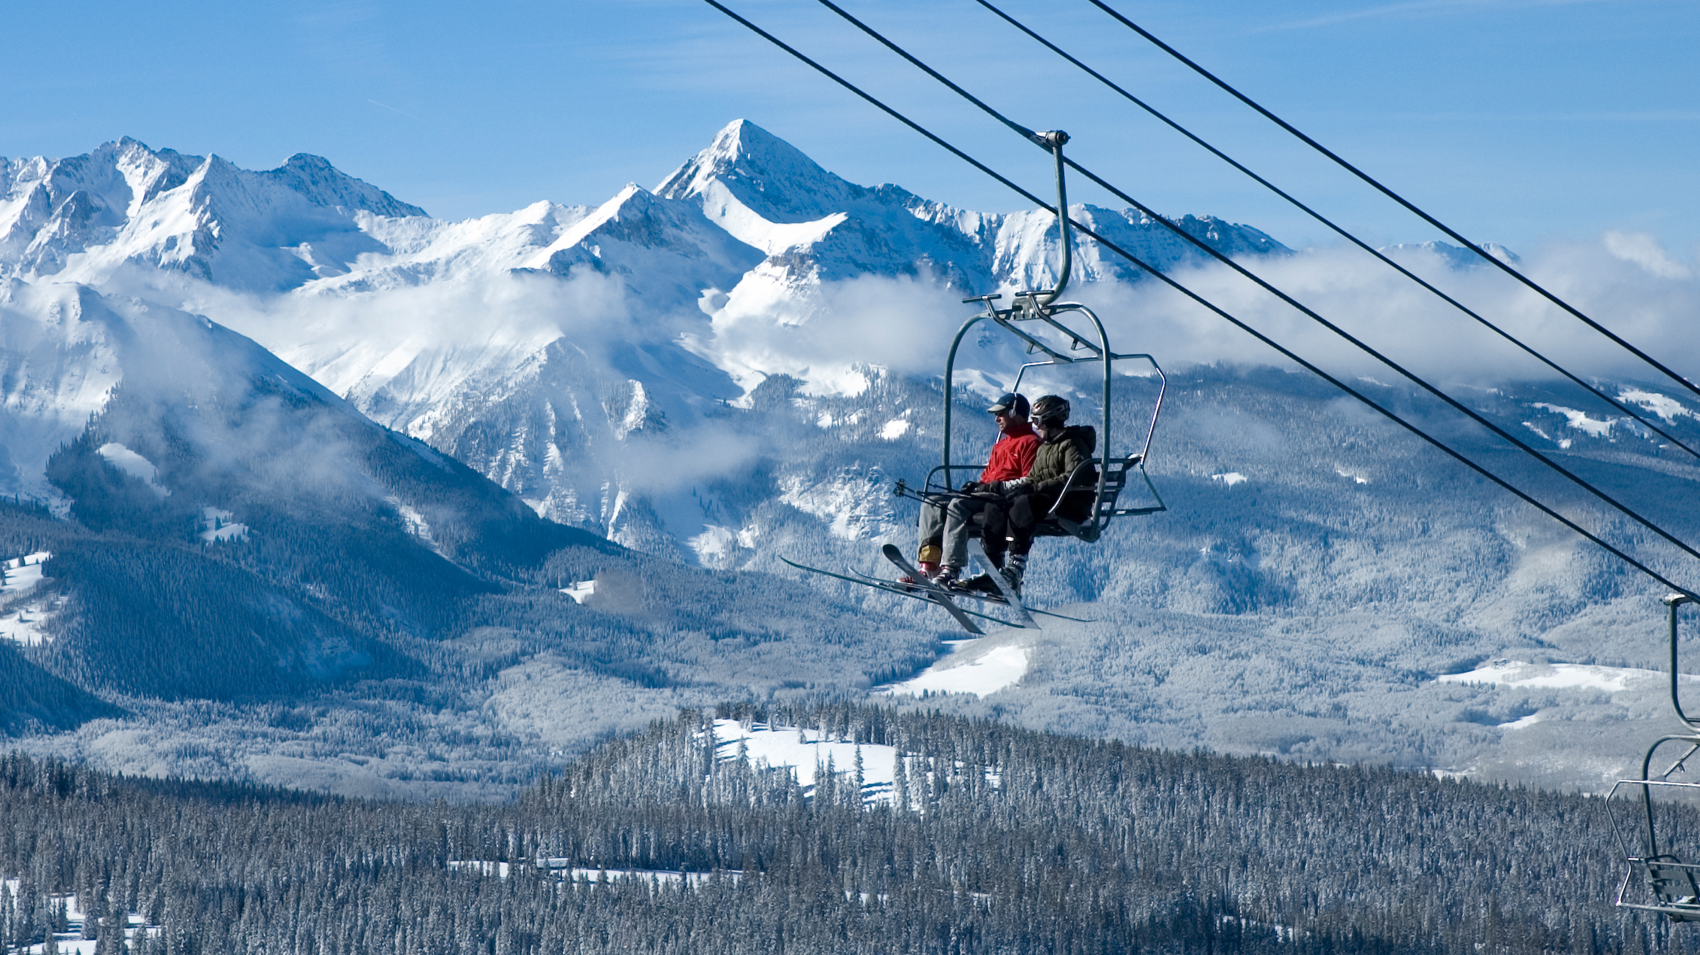
Thank you!
Special thanks to John Grayson and Max Payson for answering my questions regarding the app/JavaScript

